Slide 1

Customer Shopping Behavior Analysis
Uncovering insights from 3,900 purchases to guide strategic business decisions.

Slide 2
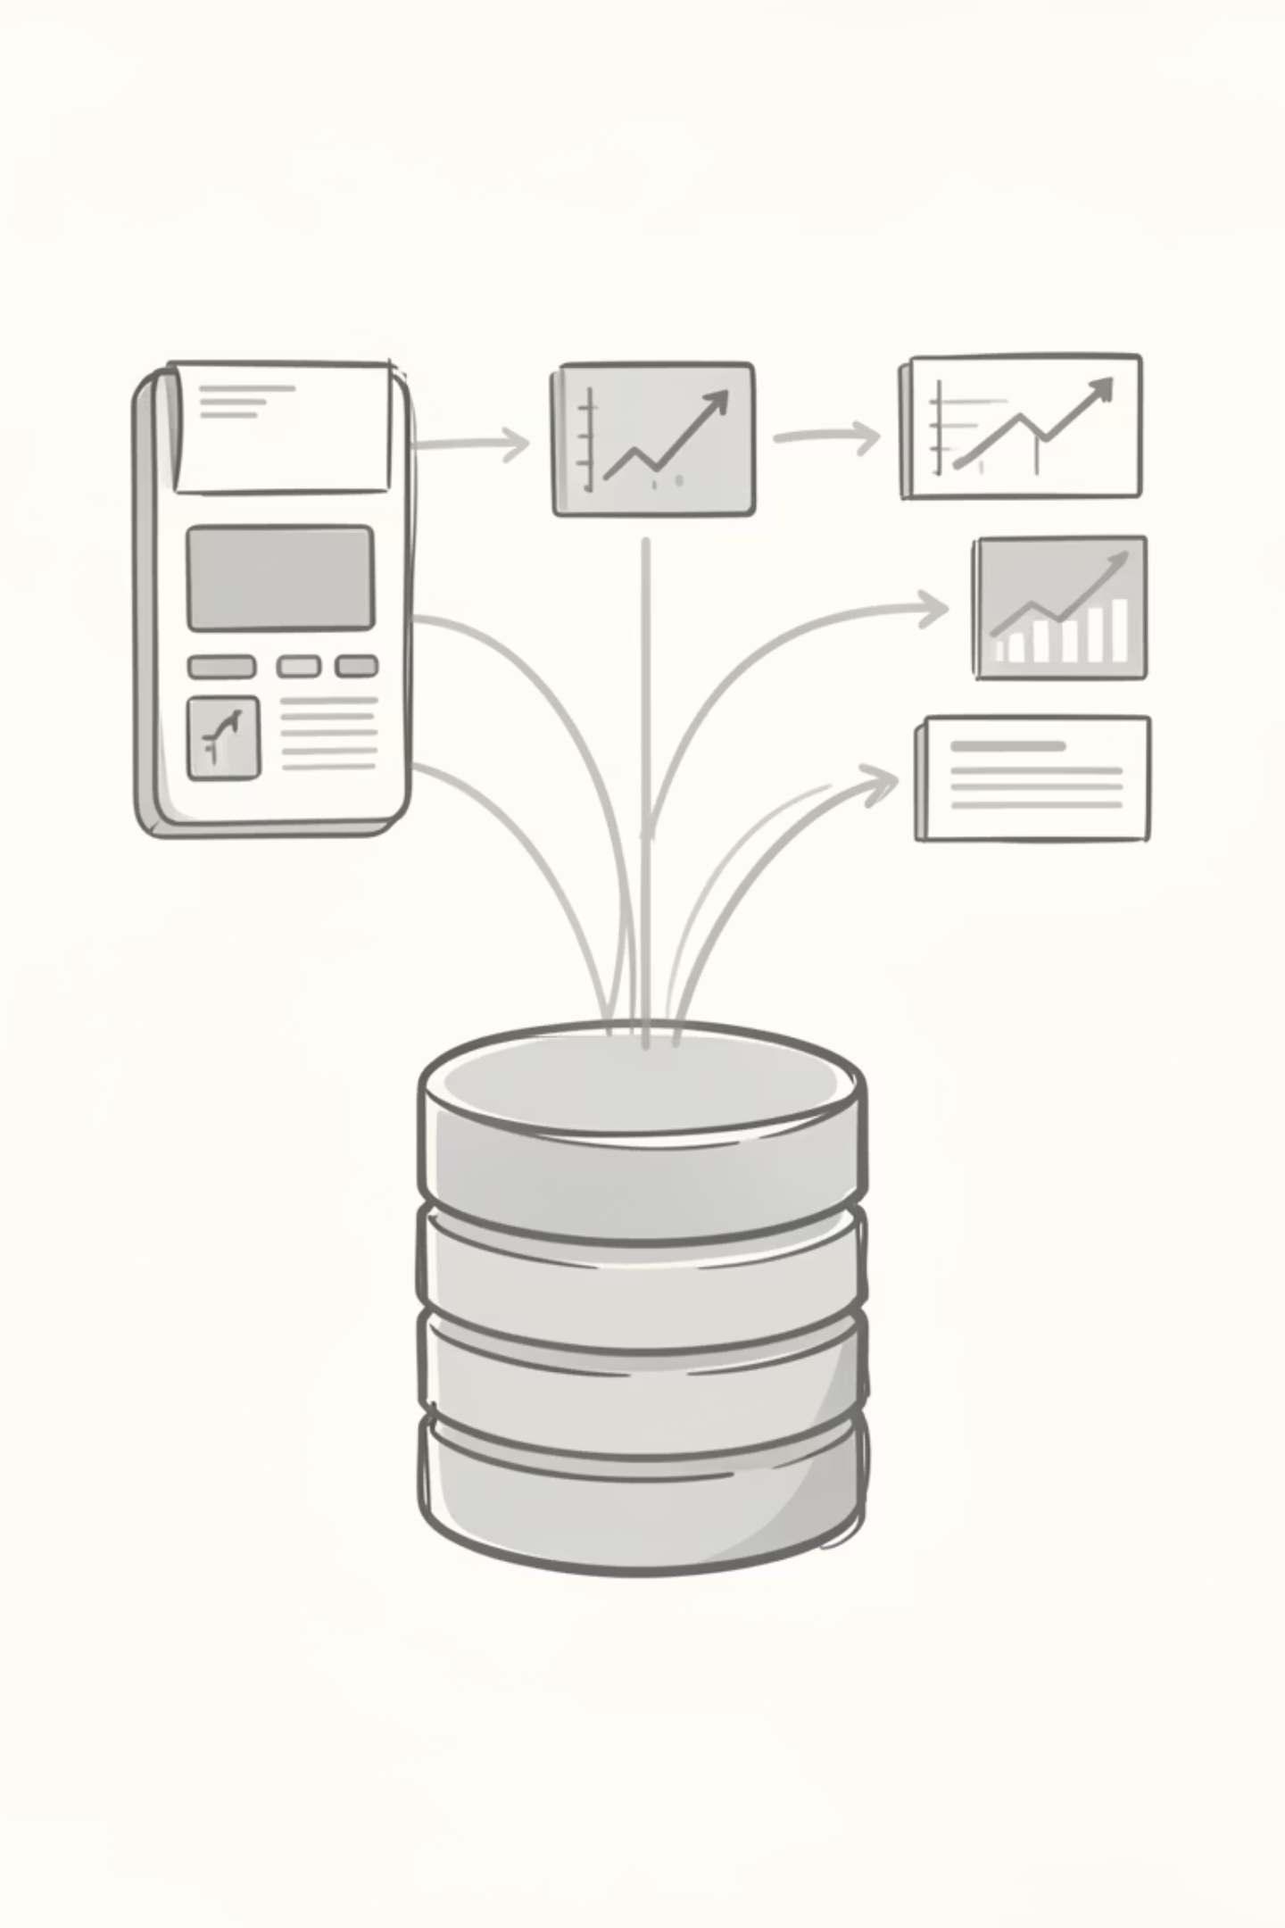
Project Overview & Dataset Summary
Project Goal
Analyze spending patterns, customer segments, product preferences, and subscription behavior.
Dataset Snapshot
3,900 rows, 18 columns, including demographics, purchase details, and shopping behavior.
Key Features
Age, Gender, Location, Item Purchased, Category, Purchase Amount, Review Rating, Subscription Status.

Slide 3
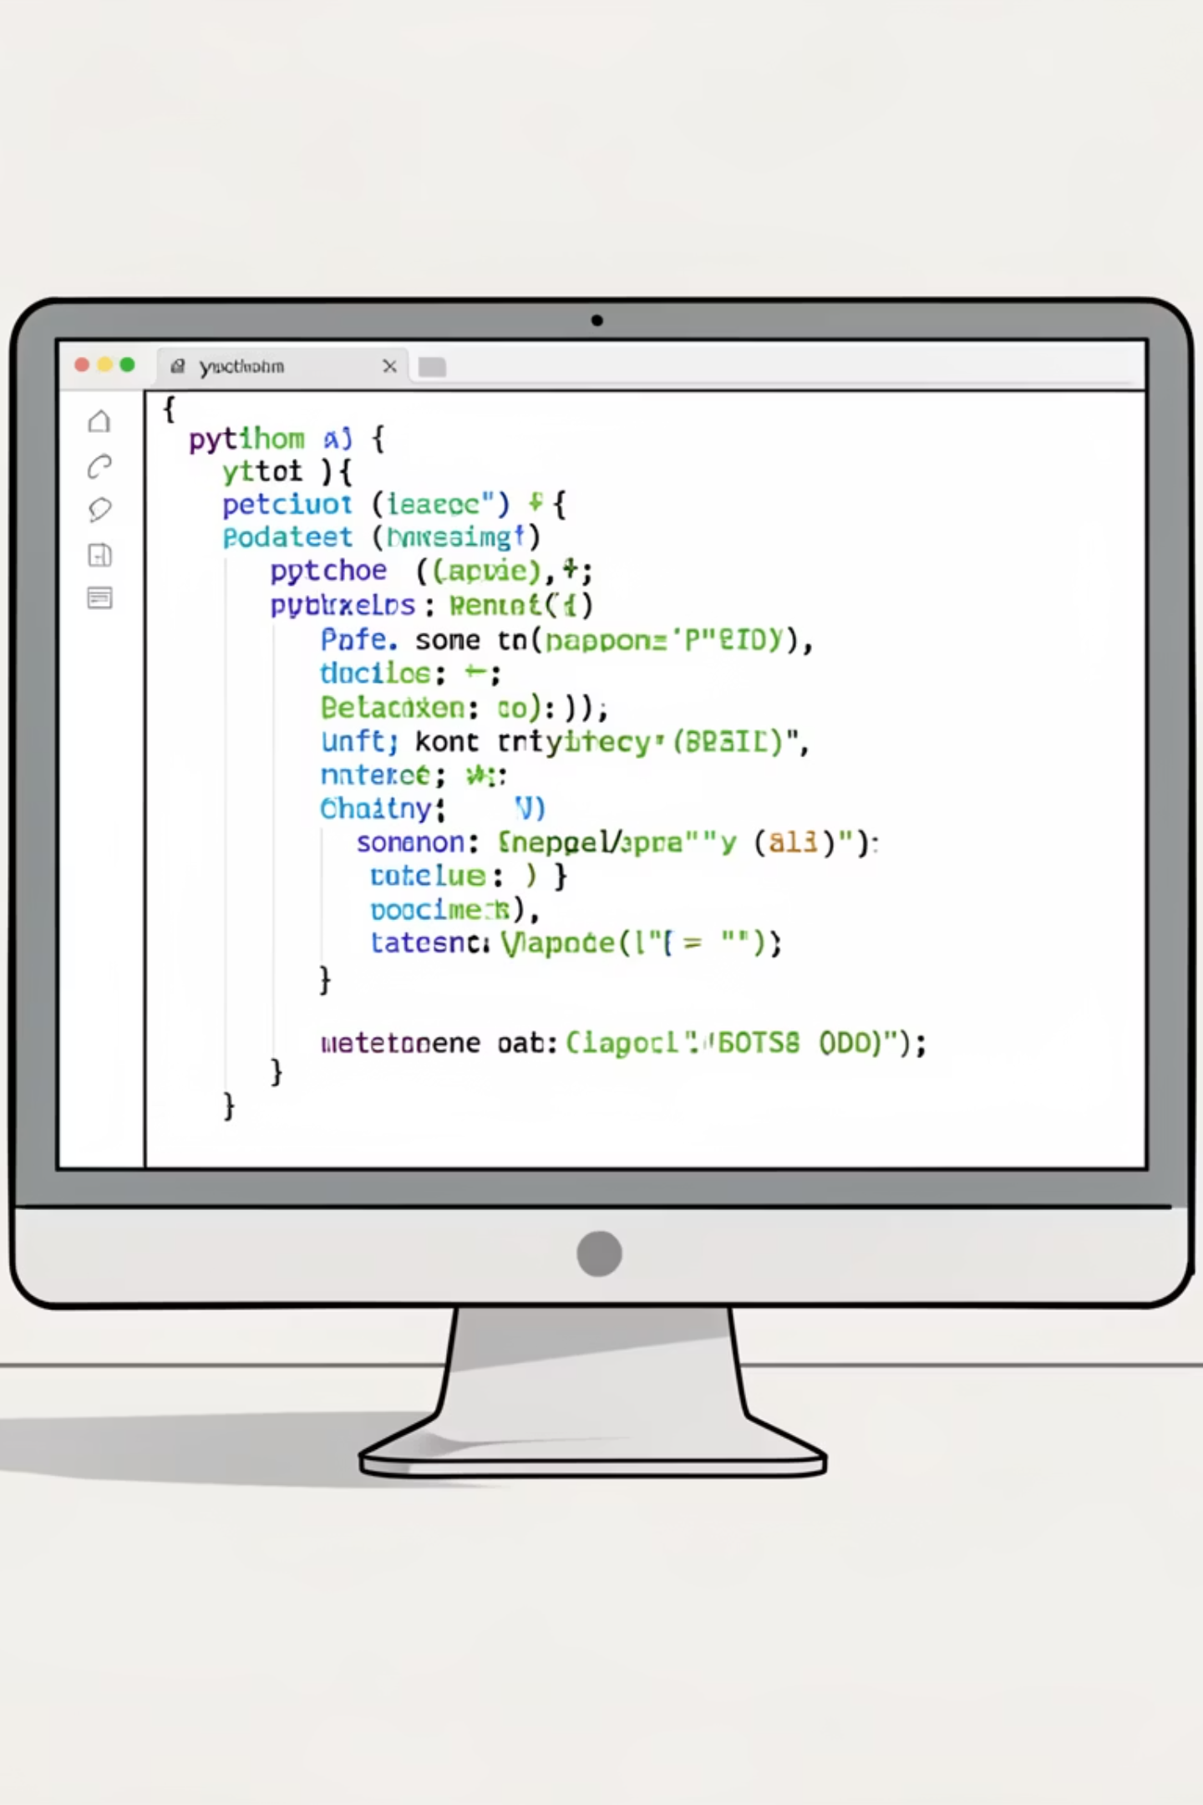
Exploratory Data Analysis (Python)
Data Preparation
Feature Engineering
Loaded dataset using `pandas`.
Created `age_group` and `purchase_frequency_days`.
Initial exploration with `df.info()` and `.describe()`.
Dropped redundant `promo_code_used` column.
Handled 37 missing `Review Rating` values by imputation.
Integrated cleaned data into PostgreSQL for SQL analysis.
Standardized column names to `snake_case`.

Slide 4
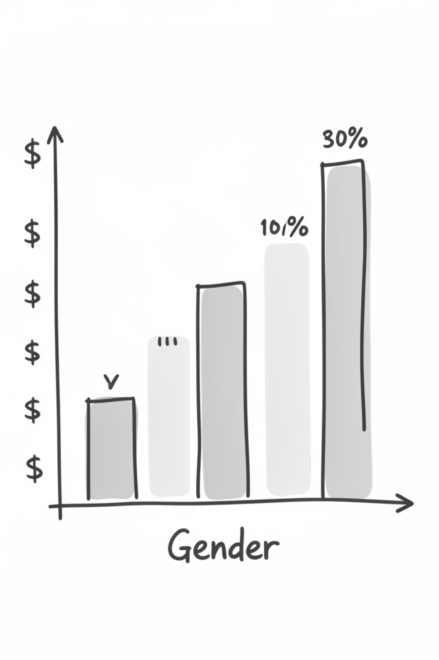
Key Business Insights: Revenue & Spending
Revenue by Gender
High-Spending Discount Users
Male customers generated $157,890, Female customers $75,191.
839 customers used discounts but spent above average.
Shipping Type Comparison
Express shipping: $60.48 avg. purchase; Standard: $58.46 avg. purchase.

Slide 5
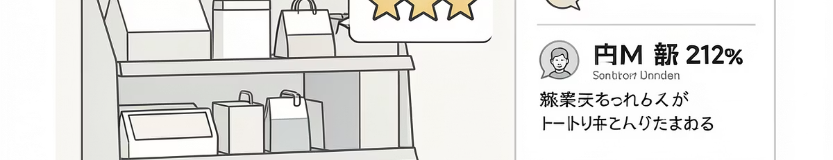
Product Performance & Preferences
Top 5 Products by Rating
Discount-Dependent Products
Gloves: 3.86
Hat: 50.00%
Sandals: 3.84
Sneakers: 49.66%
Boots: 3.82
Coat: 49.07%
Hat: 3.80
Sweater: 48.17%
Skirt: 3.78
Pants: 47.37%

Slide 6
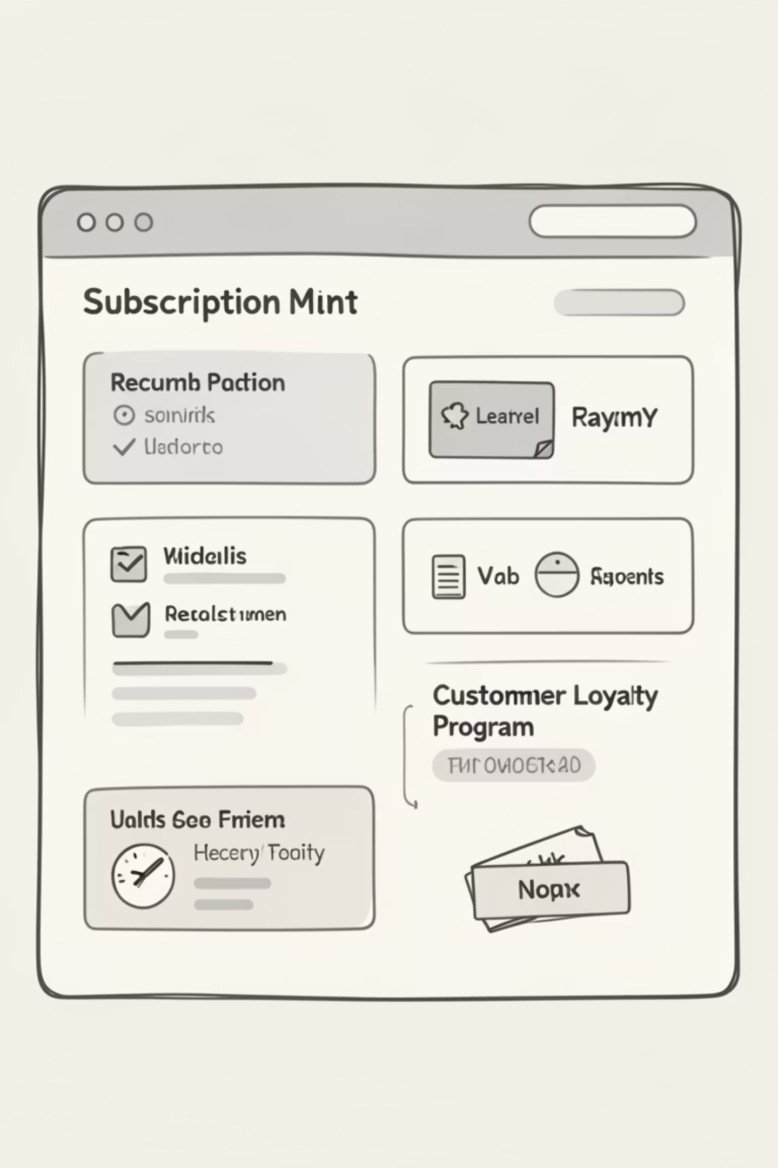
Subscription & Loyalty Analysis
1
2
Subscribers vs. Non-Subscribers
Non-Subscribers
2,847 customers, $59.87 avg. spend, $170,436 total revenue.
Subscribers: 1,053 customers, $59.49 avg. spend, $62,645 total revenue.
3
Repeat Buyers & Subscriptions
958 repeat buyers are subscribers, 2,518 are not.

Slide 7




Customer Segmentation
New
83 customers
Loyal
3,116 customers
Returning
701 customers

Slide 8
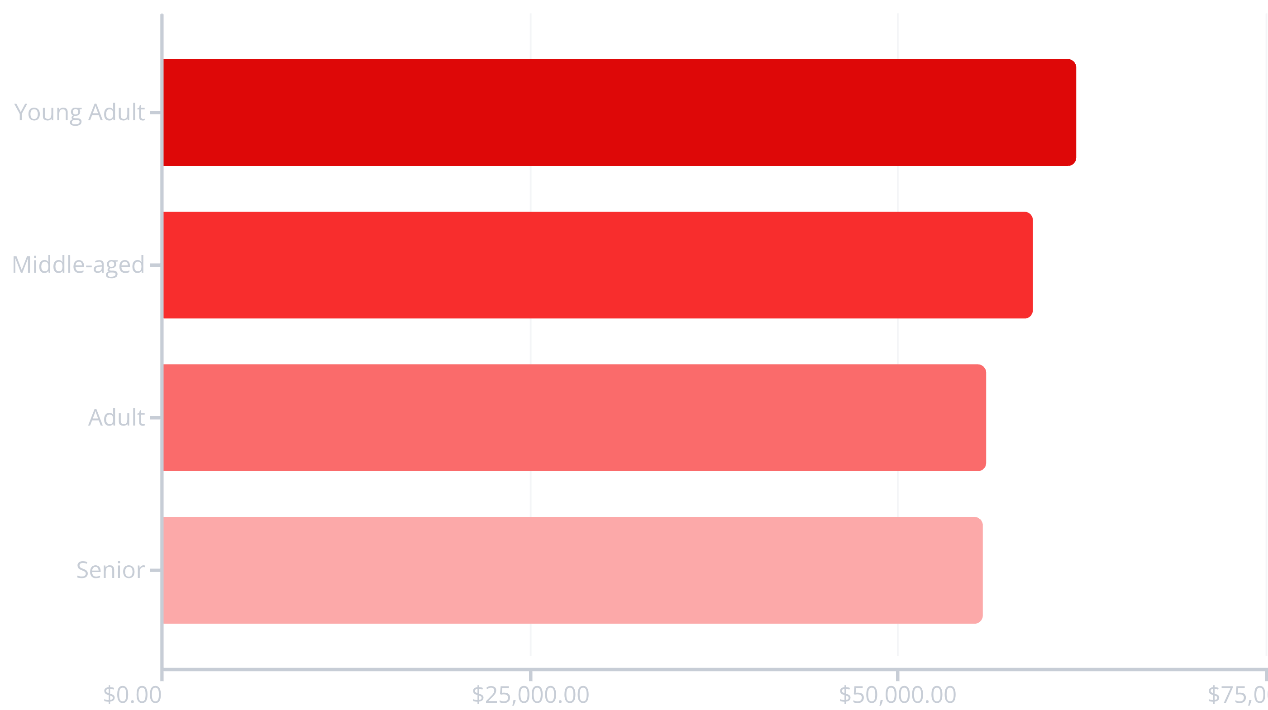
Revenue by Age Group
Young Adults contribute the most revenue, followed closely by Middle-aged customers.

Slide 9
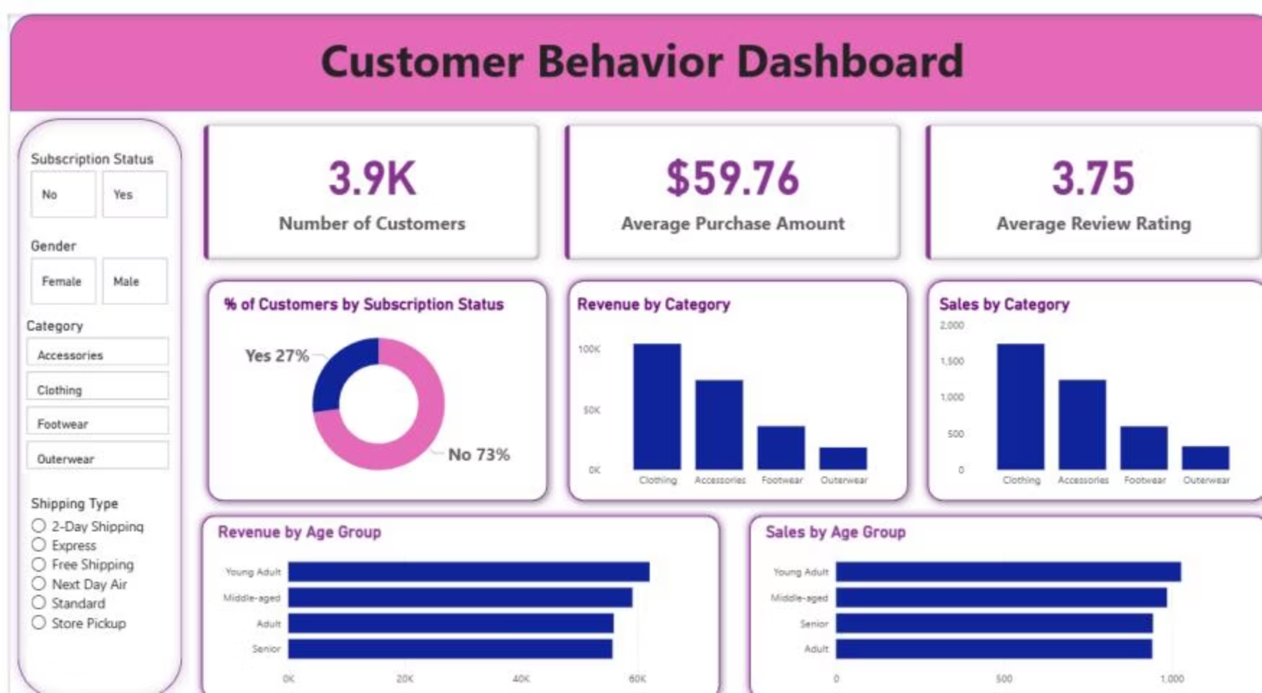


Power BI Dashboard: Visualizing Insights
An interactive dashboard presents key metrics and trends visually.
73%
27%
Customers without subscription
Customers with subscription

Slide 10





Strategic Business Recommendations
Boost Subscriptions
Promote exclusive benefits to increase subscriber base.
Customer Loyalty
Reward repeat buyers to foster loyalty and move them to "Loyal" segment.
Review Discount Policy
Balance sales boosts with margin control for optimal profitability.
Targeted Marketing
Focus efforts on high-revenue age groups and express-shipping users.

